Slide 1
Mid-term presentation: From Time-Series Parameter Extraction to Multi-Task Learning
State-of-Charge-Resolved Multi-Parameter Degradation Analysis on Li-Ion Batteries

Slide 2
Table of contents
Research Background & Objectives
Literature Review
Data Processing and Resistance Extraction Progress
Preliminary Findings and Current Problems
Next-stage Research Plan

Slide 3
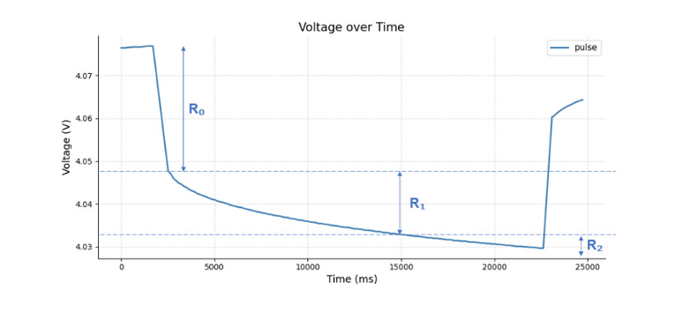
Thesis topic and motivation
Why this topic?
Degradation behavior varies across SOC levels
R₀, R₁ and R₂ reflect different parts of the voltage response
SOC-resolved resistance parameters can improve battery health characterization
Extracted parameters will be used for multi-task learning based health prediction
Notes:
My thesis focuses on state-of-charge-resolved degradation analysis of lithium-ion batteries.
In battery aging, the degradation is not only reflected by capacity fade, but also by resistance growth.
Therefore, only using capacity or SOH may not be sufficient to describe the internal degradation behavior of the cell.
The figure on the right shows a typical pulse-relaxation voltage response.
From this curve, the instantaneous voltage drop can be used to estimate the ohmic resistance R0, while the following relaxation behavior can be further described by R1 and R2 in a second-order RC model.
The motivation of this work is to extract these resistance-related parameters at 10%, 50% and 90% SOC levels, and analyze how they evolve with aging.
In the next step, these extracted parameters will be used as input features for multi-task learning models, in order to predict battery health and compare degradation patterns across different battery chemistries.

Slide 4
Objectives
Raw aging pulse-test data
SOC-resolved parameter extraction
Capacity + R₀ + R₁ + R₂
Multi-task learning model
Battery health prediction
Chemistry-specific degradation comparison

Slide 5
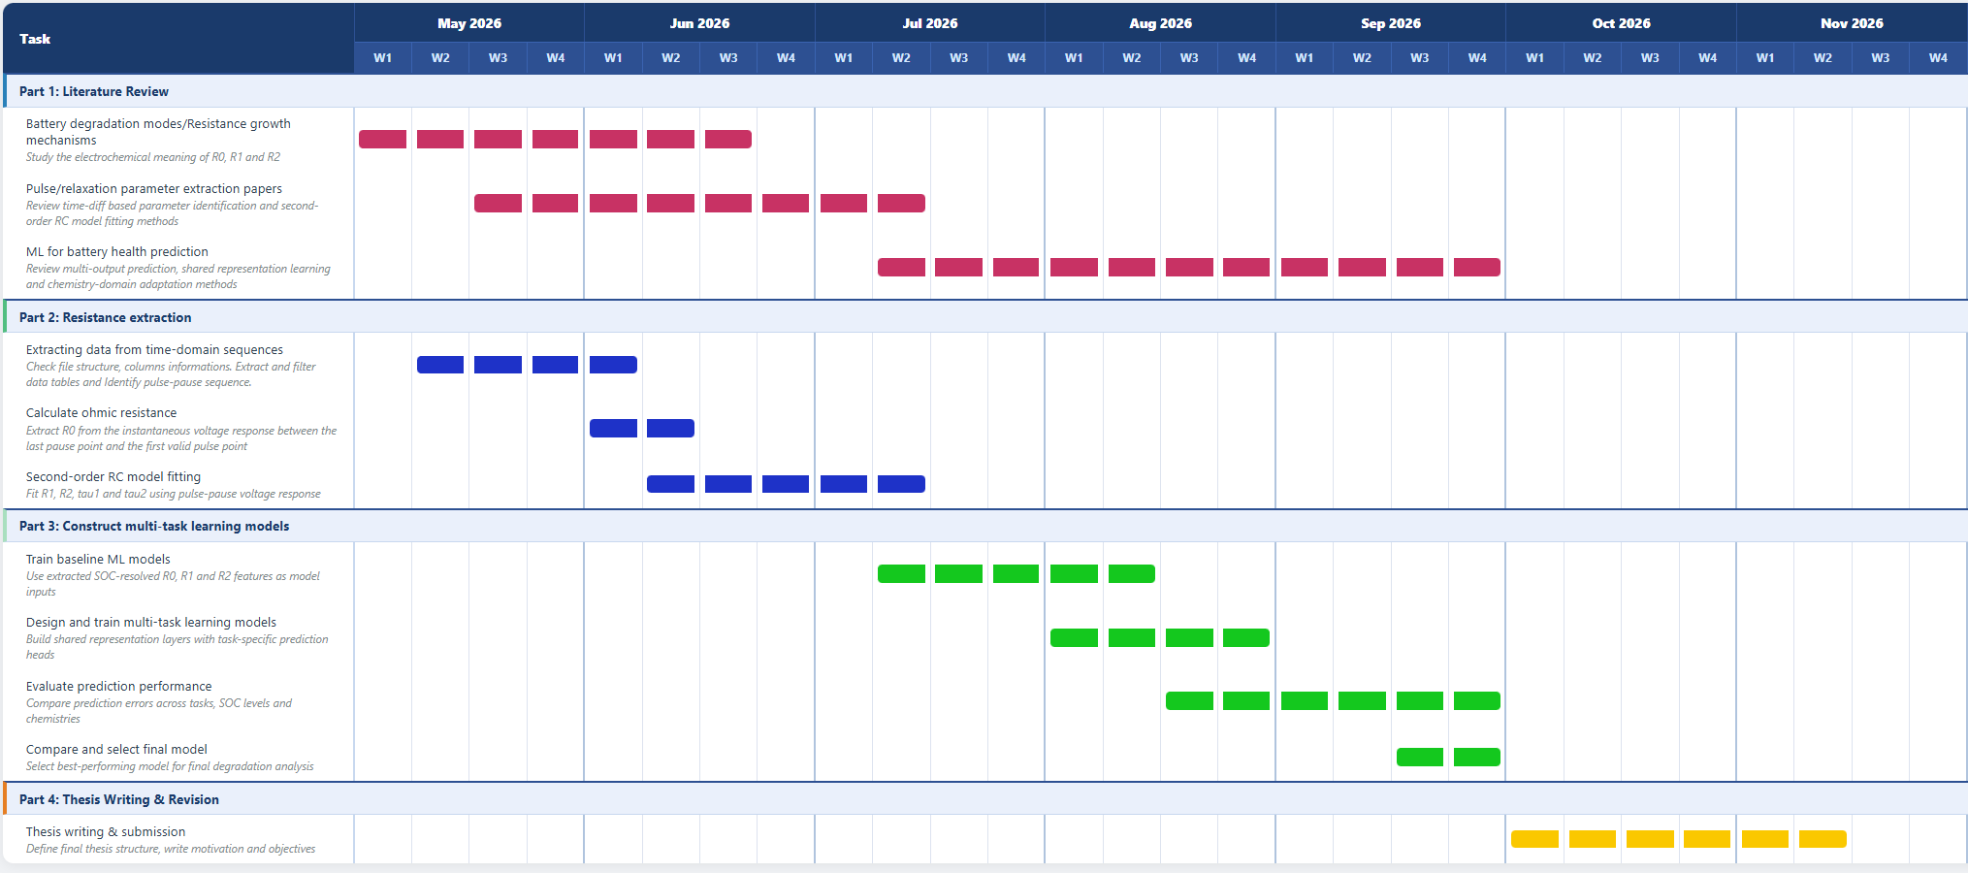
Gantt Bilder

Slide 6
Table of contents
Research Background & Objectives
Literature Review
Data Processing and Resistance Extraction Progress
Preliminary Findings and Current Problems
Next-stage Research Plan

Slide 7
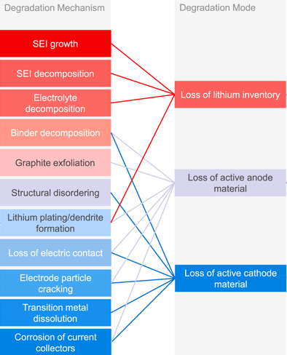
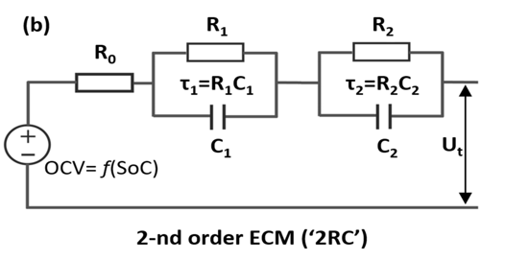
Literature Review: From Battery Aging Mechanisms to 2RC Parameter Extraction
2RC Thevenin model captures fast and slow voltage relaxation.
R₀ represents the instantaneous ohmic resistance.
R₁/τ₁ and R₂/τ₂ describe fast and slow polarization dynamics.
Multiple coupled degradation mechanisms cause battery aging.
Journal of Power Sources, Birkl et al., 2017
Excitation Pulse Influence on the Accuracy and Robustness of Equivalent Circuit Model Parameter Identification for Li-Ion Batteries.Grebtsov et al., 2026
Notes:
This slide explains the connection between battery aging and 2RC model parameter extraction.
Battery aging is caused by several coupled degradation mechanisms, including SEI growth, lithium plating, active material loss. These internal mechanisms are difficult to measure directly, but their effects appear at the cell level as capacity fade, resistance growth, and slower voltage relaxation.
To describe these external voltage responses, this thesis uses a time-domain 2RC Thevenin model. R-zero represents the instantaneous ohmic resistance, while the two RC branches describe fast and slow polarization processes.
Therefore, by fitting pulse-pause voltage data, R-zero, R-one, and R-two can be extracted as indicators of the battery’s dynamic behavior under different SOC conditions. This provides the basis for the parameter identification work at 10%, 50%, and 90% SOC.

Slide 8
Table of contents
Research Background & Objectives
Literature Review
Data Processing and Resistance Extraction Progress
Preliminary Findings and Current Problems
Next-stage Research Plan

Slide 9
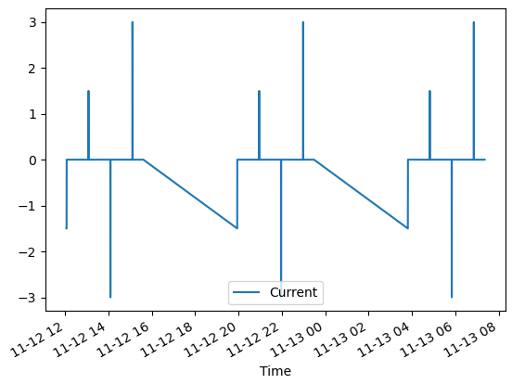
Data processing：From Raw Time Series to Pulse-Pause Pairs
Data processing steps：
1. SOH extraction from filename
2. Time-based cycle segmentation
3. SOC assignment: 90%, 50%, 10%
4. Stable pulse filtering
5. Previous PAUO(pause)–pulse matching
The last PAUO point before the pulse is matched with the first valid pulse point.
Notes:
In this step, I process the raw time-series data and convert it into valid pulse-pause pairs for resistance extraction.
First, I read the raw parquet files and extract the SOH information from the file name. Then, the data are sorted by time, and the major cycles are identified based on the time difference between neighboring data points.
According to the experimental sequence, these cycles are assigned to three SOC levels: 90%, 50%, and 10%.
After that, I filter the pulse segments. Only stable charging and discharging pulses are kept.
Finally, for each valid pulse, I match the last PAUO point before the pulse with the first valid pulse point. This matched PAUO-pulse pair is the basis for the following R0 calculation and second-order RC fitting.

Slide 10
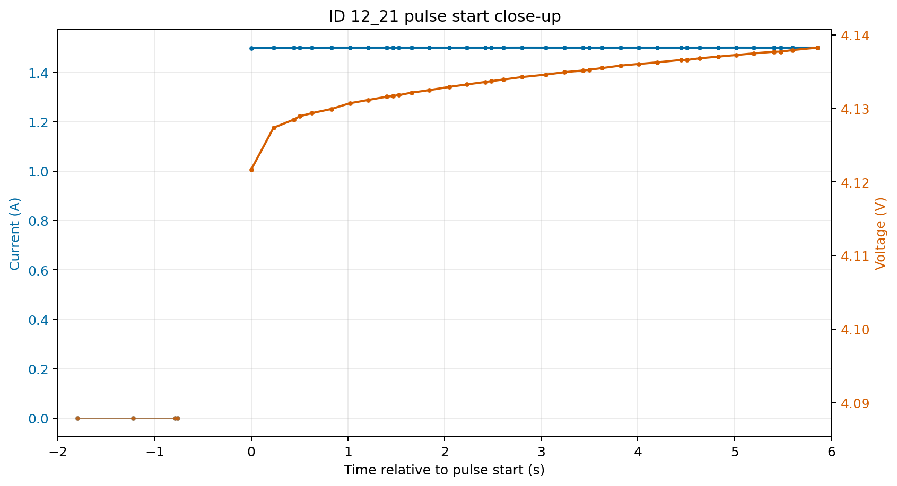
R₀ Calculation: Instantaneous Ohmic Resistance
R₀ calculation
Last PAUO point → first valid pulse point
R₀ = |ΔV / ΔI| × 1000
ΔV: instantaneous voltage change
ΔI: first valid pulse point after current change
Result: R₀ in mΩ
Notes:
After matching each pulse with the previous PAUO point, I calculate the ohmic resistance R0 from the instantaneous voltage and current change at the pulse start.
In this figure, the blue curve shows the current and the orange curve shows the voltage. Before the pulse, the current is approximately zero. When the pulse starts, the current jumps to the target level, and the voltage shows an immediate response.
I use the last PAUO point before the pulse and the first valid pulse point to calculate R0. The formula is R0 equals the absolute value of delta voltage divided by delta current. The result is multiplied by 1000 and reported in milliohm.
This R0 value is then used as the fixed ohmic resistance input for the following second-order RC fitting.

Slide 11
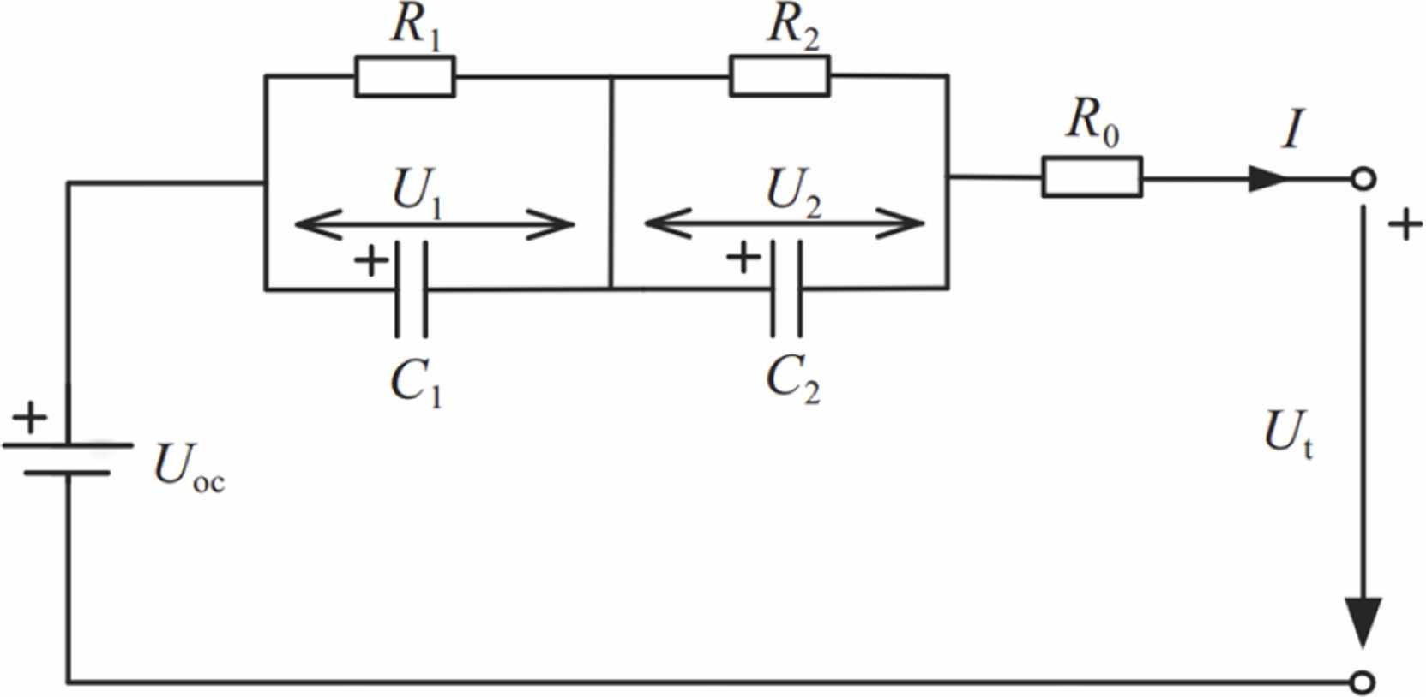

Second-order RC model for resistance extraction
Second-order Thévenin ECM
    R₀: instantaneous ohmic resistance
    R₁C₁: fast relaxation component
    R₂C₂: slow relaxation component
    τ₁ = R₁C₁, τ₂ = R₂C₂
For $I$ > 0, Discharge:
$$u1\left(t\right)=IR_{1}{(1−e}^{−\frac{t}{τ_{1}}})$$
$$u2\left(t\right)=IR_{2}{(1−e}^{−\frac{t}{τ_{2}}})$$
$$ut=u_{oc} − IR_{0}\text{ −} u_{1} \text{−} u_{2}$$
Notes:
This slide shows the second-order Thévenin equivalent circuit model used for resistance extraction.
R0 describes the instantaneous ohmic response and is fixed from the previous R0 calculation. The two RC branches describe the dynamic relaxation behavior after the pulse. R1C1 captures the faster relaxation component, while R2C2 captures the slower relaxation component.
The equations on the right are written for the discharge-positive current convention. Therefore, during discharge, the terminal voltage is the open-circuit voltage minus the ohmic drop and the two polarization voltages.
In the fitting step, R1, R2, tau1 and tau2 are identified from the pulse-pause voltage curve and later used as SOC-resolved degradation features.

Slide 12
Table of contents
Research Background & Objectives
Literature Review
Data Processing and Resistance Extraction Progress
Preliminary Findings and Current Problems
Next-stage Research Plan

Slide 13
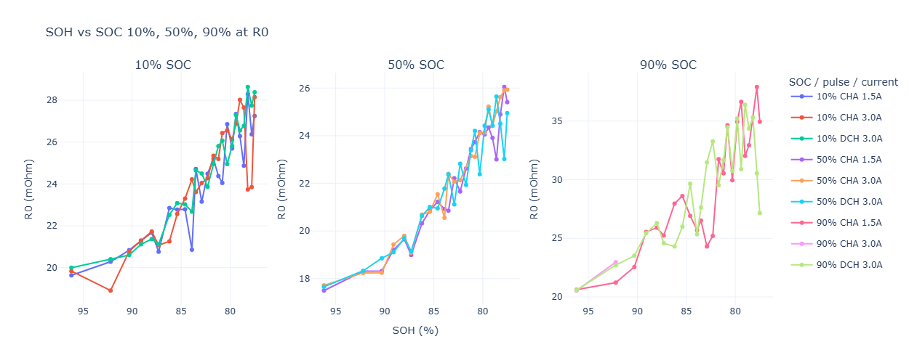
Preliminary results
R₀ results
Notes:
These three figures show the identified resistance parameters R-zero, R-one, and R-two as a function of SOH under different SOC levels and pulse conditions.
The x-axis represents SOH. Since SOH decreases from left to right, the right side of each plot corresponds to a more aged battery condition. The three subplots in each figure correspond to 10%, 50%, and 90% SOC, respectively. Within each SOC group, different curves represent different pulse directions and current magnitudes.
First, for R-zero, which represents the instantaneous ohmic resistance, a clear increasing trend can be observed as SOH decreases.
This trend appears at all three SOC levels, indicating that battery aging leads to an increase in ohmic resistance. At 10% and 50% SOC, the curves are relatively consistent between different pulse conditions, which suggests that R-zero can be identified quite robustly.
However, at 90% SOC, the R-zero values are generally higher and show stronger fluctuations, especially in the lower SOH range. This means that the ohmic resistance is not only affected by aging, but also becomes more sensitive to SOC and excitation conditions at high SOC.

Slide 14
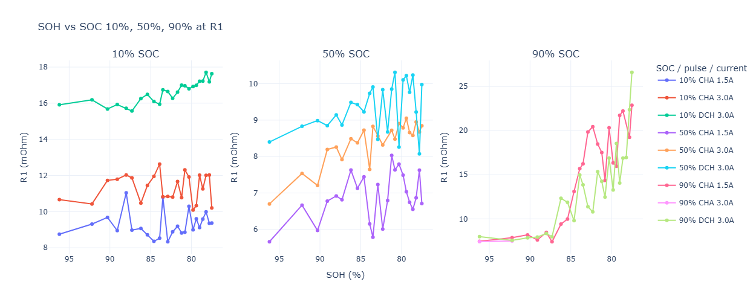
Preliminary results
R₁ results
Notes:
This figure shows R-one, which represents the fast polarization resistance in the 2RC model.
Compared with R-zero, R-one is more sensitive to SOC and pulse direction. At 10% SOC, the 3.0 A discharge pulses give consistently higher R-one values than the charge pulses. At 50% SOC, the values are generally lower, but the discharge case still shows larger fluctuations.
At 90% SOC, R-one increases clearly as SOH decreases, especially below about 86% SOH. This suggests stronger fast polarization effects in aged cells under high-SOC conditions.

Slide 15
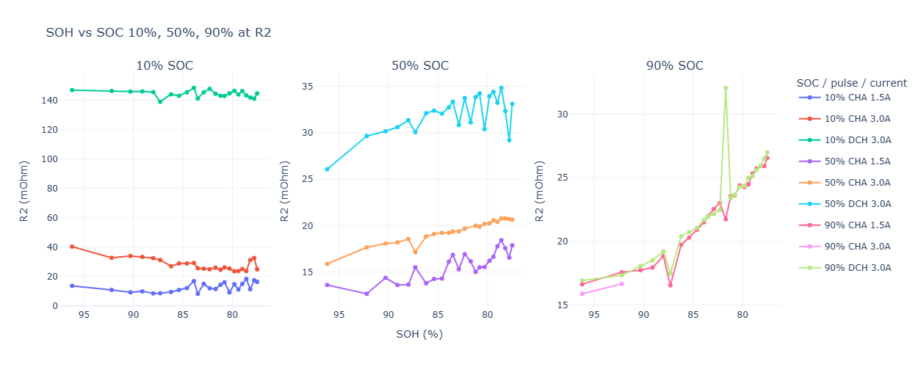
Preliminary results
R₂ results
Notes:
This figure shows R-two, which represents the slow polarization resistance in the 2RC model.
R-two shows stronger condition dependence than R-one. At 10% SOC, the 3.0 A discharge case gives exceptionally high values, while the charge cases remain much lower. At 50% SOC, R-two generally increases with aging, but the discharge results are still higher and more variable.
At 90% SOC, the curves show a clearer increasing trend as SOH decreases. Overall, R-two contains useful slow-polarization information, but it is more sensitive to pulse conditions and fitting robustness.

Slide 16
Current Problems and Key Observations
R₀ includes a portion of the polarization resistance.
This may lead to an overestimation of the pure ohmic resistance.
SOC-dependent τ₂ bounds were applied to stabilize the RC fitting and separate fast/slow relaxation dynamics.
For 10% SOC discharge, τ₂ frequently reaches the 600 s upper bound.
This suggests limited identifiability of the slow RC branch rather than a precise τ₂ estimate.
Notes:
On this slide, I would like summarize the main issues observed in the current fitting results. First, the estimated R₀ may still include part of the polarization response, because it is calculated from the voltage jump over a finite time difference. Therefore, R₀ should be interpreted as an apparent ohmic resistance rather than a purely instantaneous resistance.
Second, SOC-dependent bounds were applied to τ₂ in the second-order RC model. The purpose was to stabilize the nonlinear fitting and maintain a clear separation between the fast and slow relaxation branches.
However, one important observation is that, during discharge at 10% SOC, τ₂ frequently reaches the 600-second upper bound. This does not necessarily mean that the real time constant is exactly 600 seconds. Instead, it suggests that the slow relaxation process is not fully identifiable within the available PAUO window.

Slide 17
Table of contents
Research Background & Objectives
Literature Review
Data Processing and Resistance Extraction Progress
Preliminary Findings and Current Problems
Next-stage Research Plan

Slide 18
Next-stage Research Plan
Build MTL dataset from extracted pulse-pause features and labels.
Train and compare single-task vs multi-task models.
Evaluate generalization across SOC, current, and pulse direction.
Investigate how to handle uncertain R₂ labels caused by boundary-active τ₂.

Slide 19
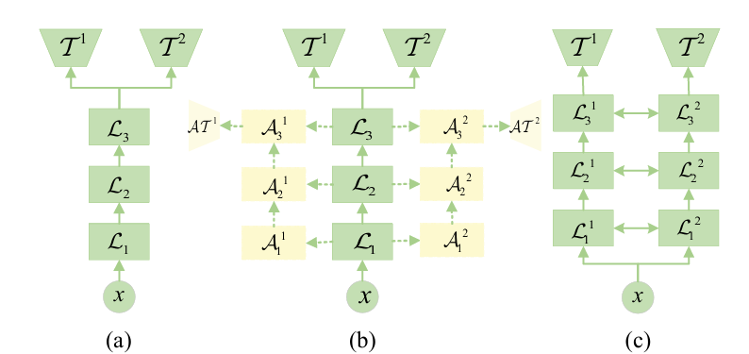
Multi-Task Learning Baselines: Fixed Sharing and Health-Oriented Auxiliary Learning
Shared-bottom MTL:
Shared encoder learns common degradation representation; task-specific heads predict SOH, R₀, R₁, R_{2.}
Assumes that a fixed shared representation is useful for all tasks across SOC and pulse conditions.
Baseline architecture — simple, low parameter count, suited to limited sample size.
Auxiliary MTL:
Reframes the four tasks as unequal: SOH as primary task, R₀, R₁, R₂ as auxiliary tasks.
Auxiliary tasks (pulse-derived signals) regularize the shared representation used to predict the primary task (SOH).
Hard parameter sharing(Shared-bottom MTL)
Auxiliary learning
Soft parameter sharing
Auxiliary Learning for Deep Multi-task Learning, Liu, Y. et al., 2019
Notes:
This slide introduces two conventional multi-task learning formulations.
In shared-bottom MTL, all tasks use one common encoder and separate output heads. It is a simple and efficient baseline, but it assumes that the relationships among SOH, R-zero, R-one, and R-two are consistent across all operating conditions.
Auxiliary MTL assigns unequal roles to the tasks: SOH is the primary prediction target, while the resistance parameters provide additional degradation-related supervision.
However, neither approach can adapt the sharing pattern to different SOC or pulse conditions. This motivates the MMoE method introduced next.

Slide 20
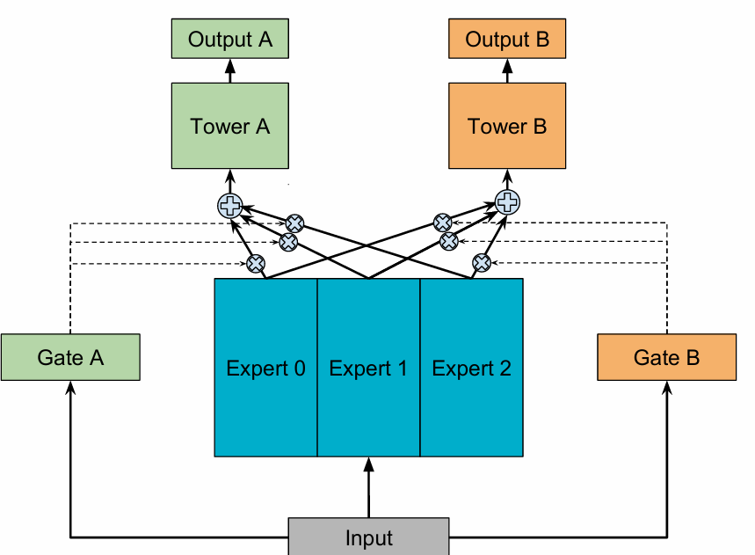
Multi-task Learning for Battery Health Prediction
MMoE(Multi-gate Mixture-of-Experts):
Multiple-experts model different aging and operating-condition patterns.
Task-specific gates adaptively select experts according to SOC and excitation conditions, reducing negative transfer.
Therefore, the degree of feature sharing can vary with SOC, current magnitude, and charge/discharge direction.
Modeling Task Relationships in Multi-task Learning with Multi-gate Mixture-of-Experts. Ma, J. et al.,2018
Notes:
The previous two approaches use either fixed feature sharing or a fixed primary–auxiliary task structure. However, in this study, the relationship between SOH and the resistance parameters may change with SOC and pulse conditions.
MMoE addresses this issue through multiple shared experts and task-specific gates. Each expert can learn a different representation from the pulse-pause response, while each task dynamically assigns different weights to these experts.
Therefore, the model can adapt the sharing pattern across SOC, current magnitude, and charge or discharge conditions.
This is my preliminary concept for the model to be adopted in the next stage.

Slide 22
Mid-term presentation: From Time-Series Parameter Extraction to Multi-Task Learning
State-of-Charge-Resolved Multi-Parameter Degradation Analysis on Li-Ion Batteries

